Slide 1
^{Wednesday,} ^{July 11, 2018}

Slide 2

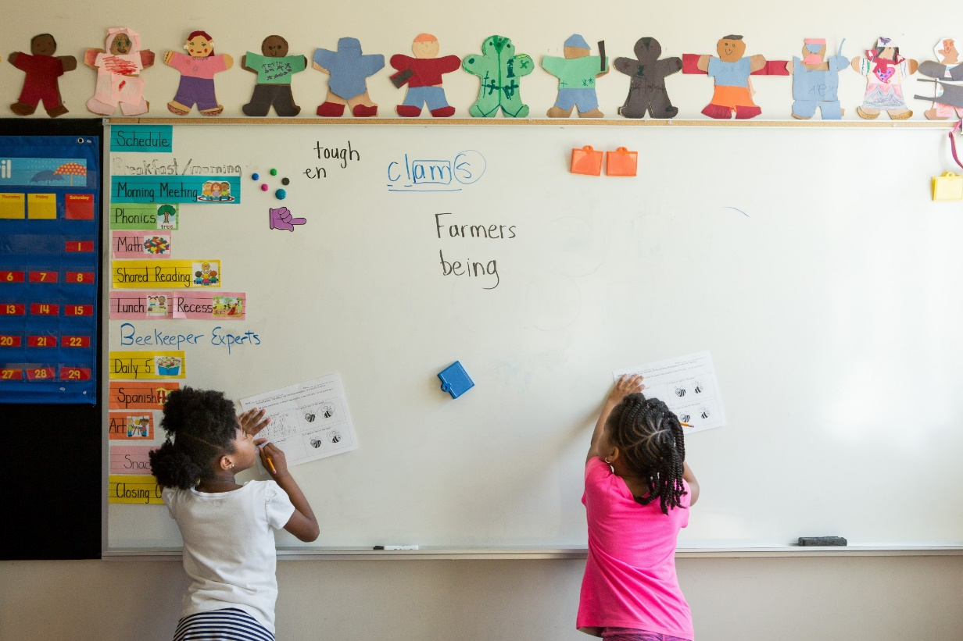


Assembly Blue Ribbon
Commission On Childhood Education
07.11.2018
MANUEL PASTOR @Prof_MPastor

Slide 3
The Next California
This generation of children is very diverse.
USC PERE| February 2018| 3

Slide 4
USC PERE| April 2018 | 4

Slide 5
USC PERE| April 2018 | 5

Slide 6
USC PERE| April 2018 | 6

Slide 10
The Next California
This generation of children is very diverse.
Growth in the next generation will occur in Central California.
USC PERE| February 2018| 10

Slide 11
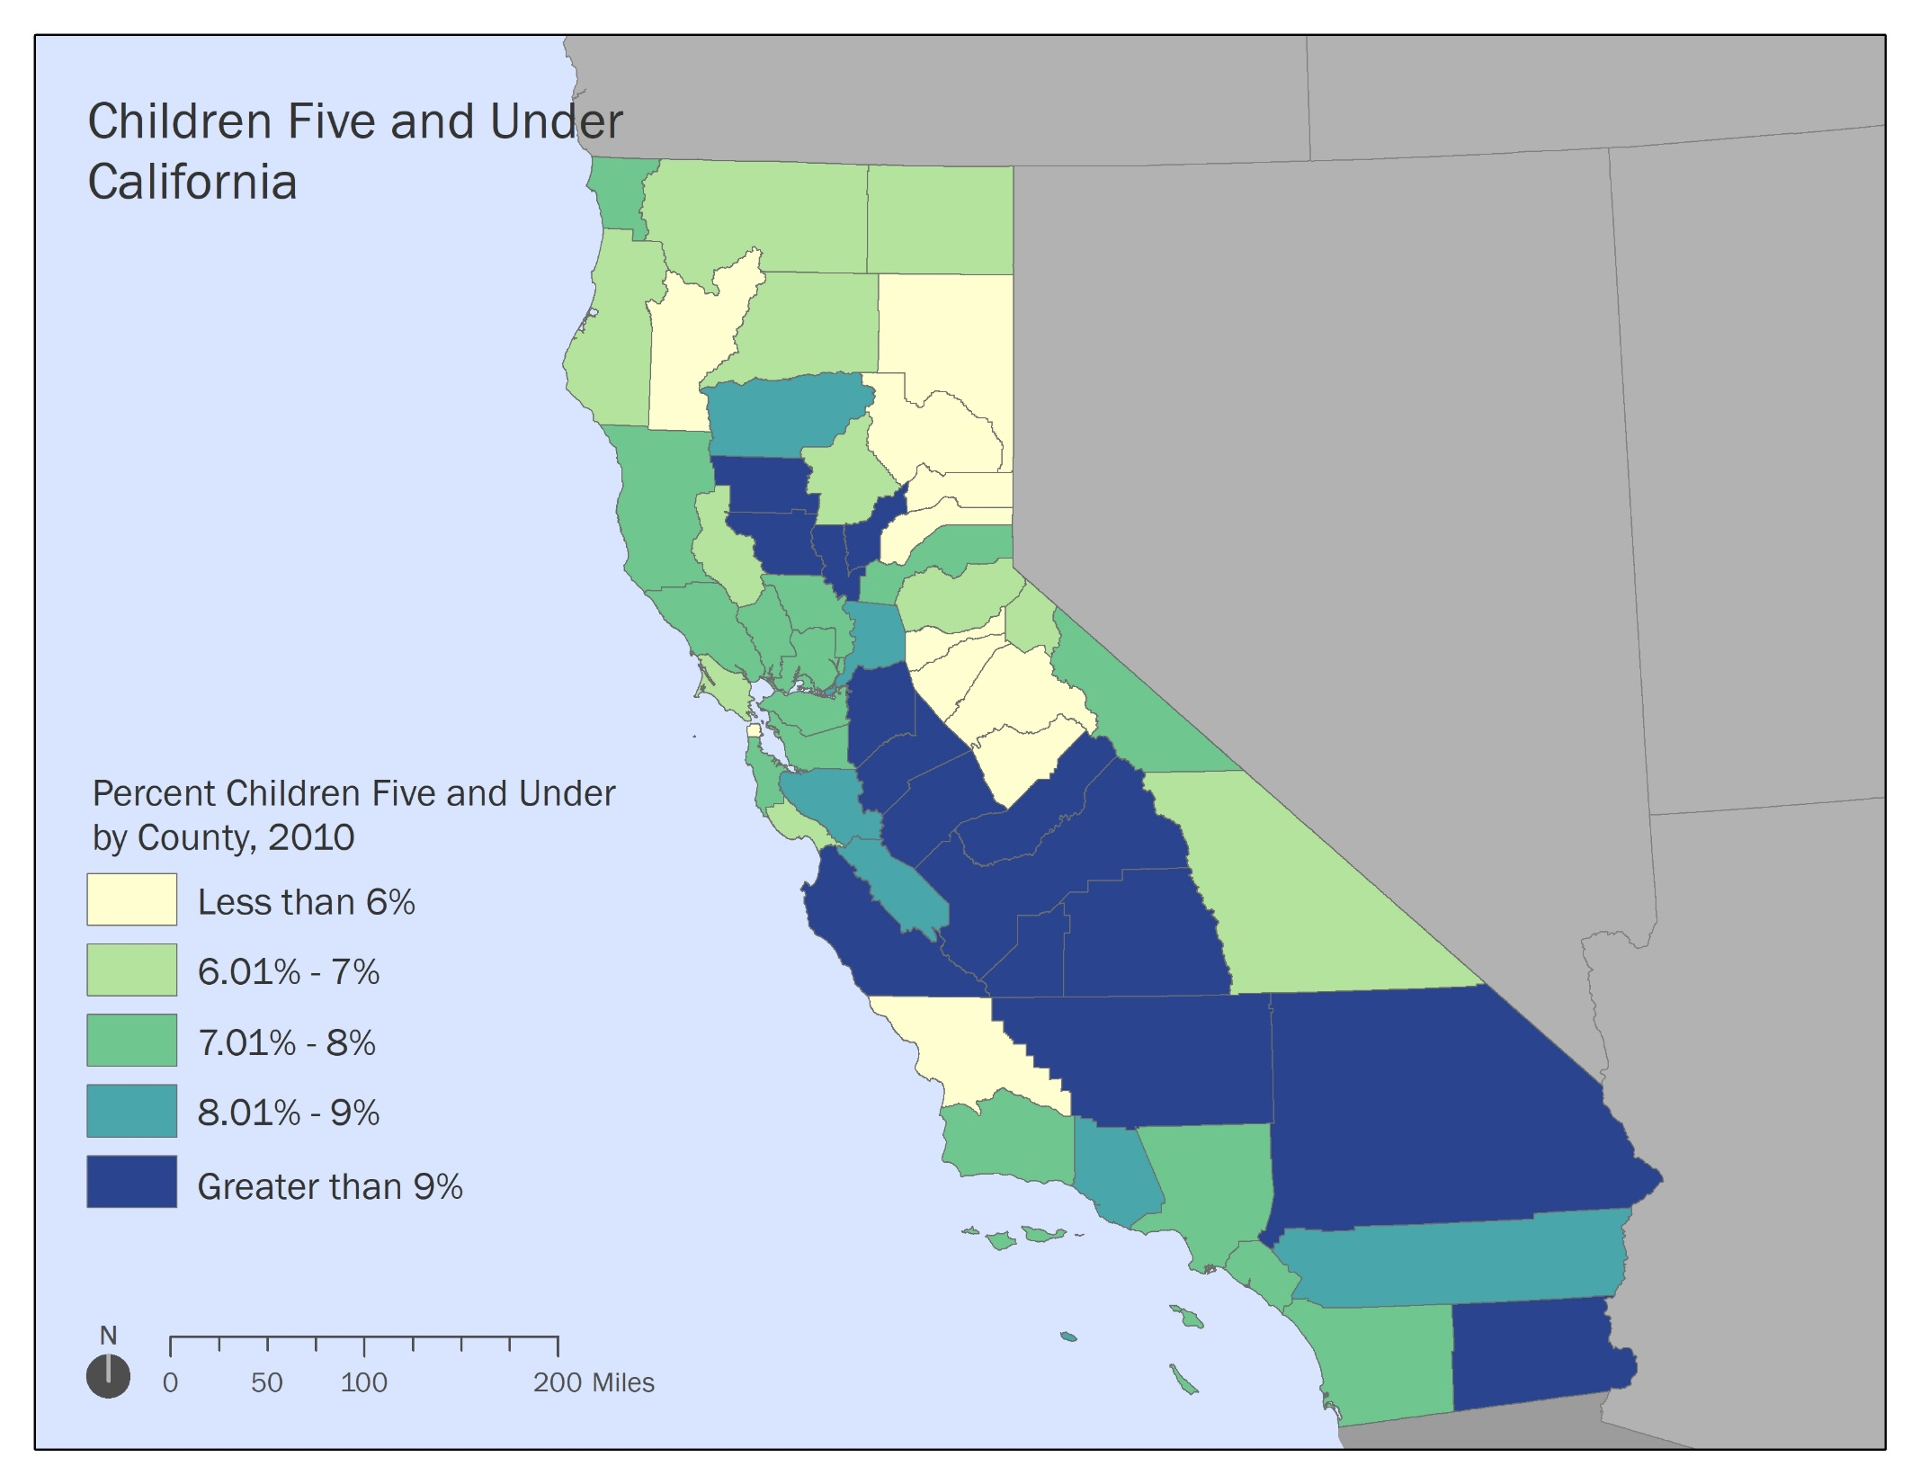
2010

Slide 12
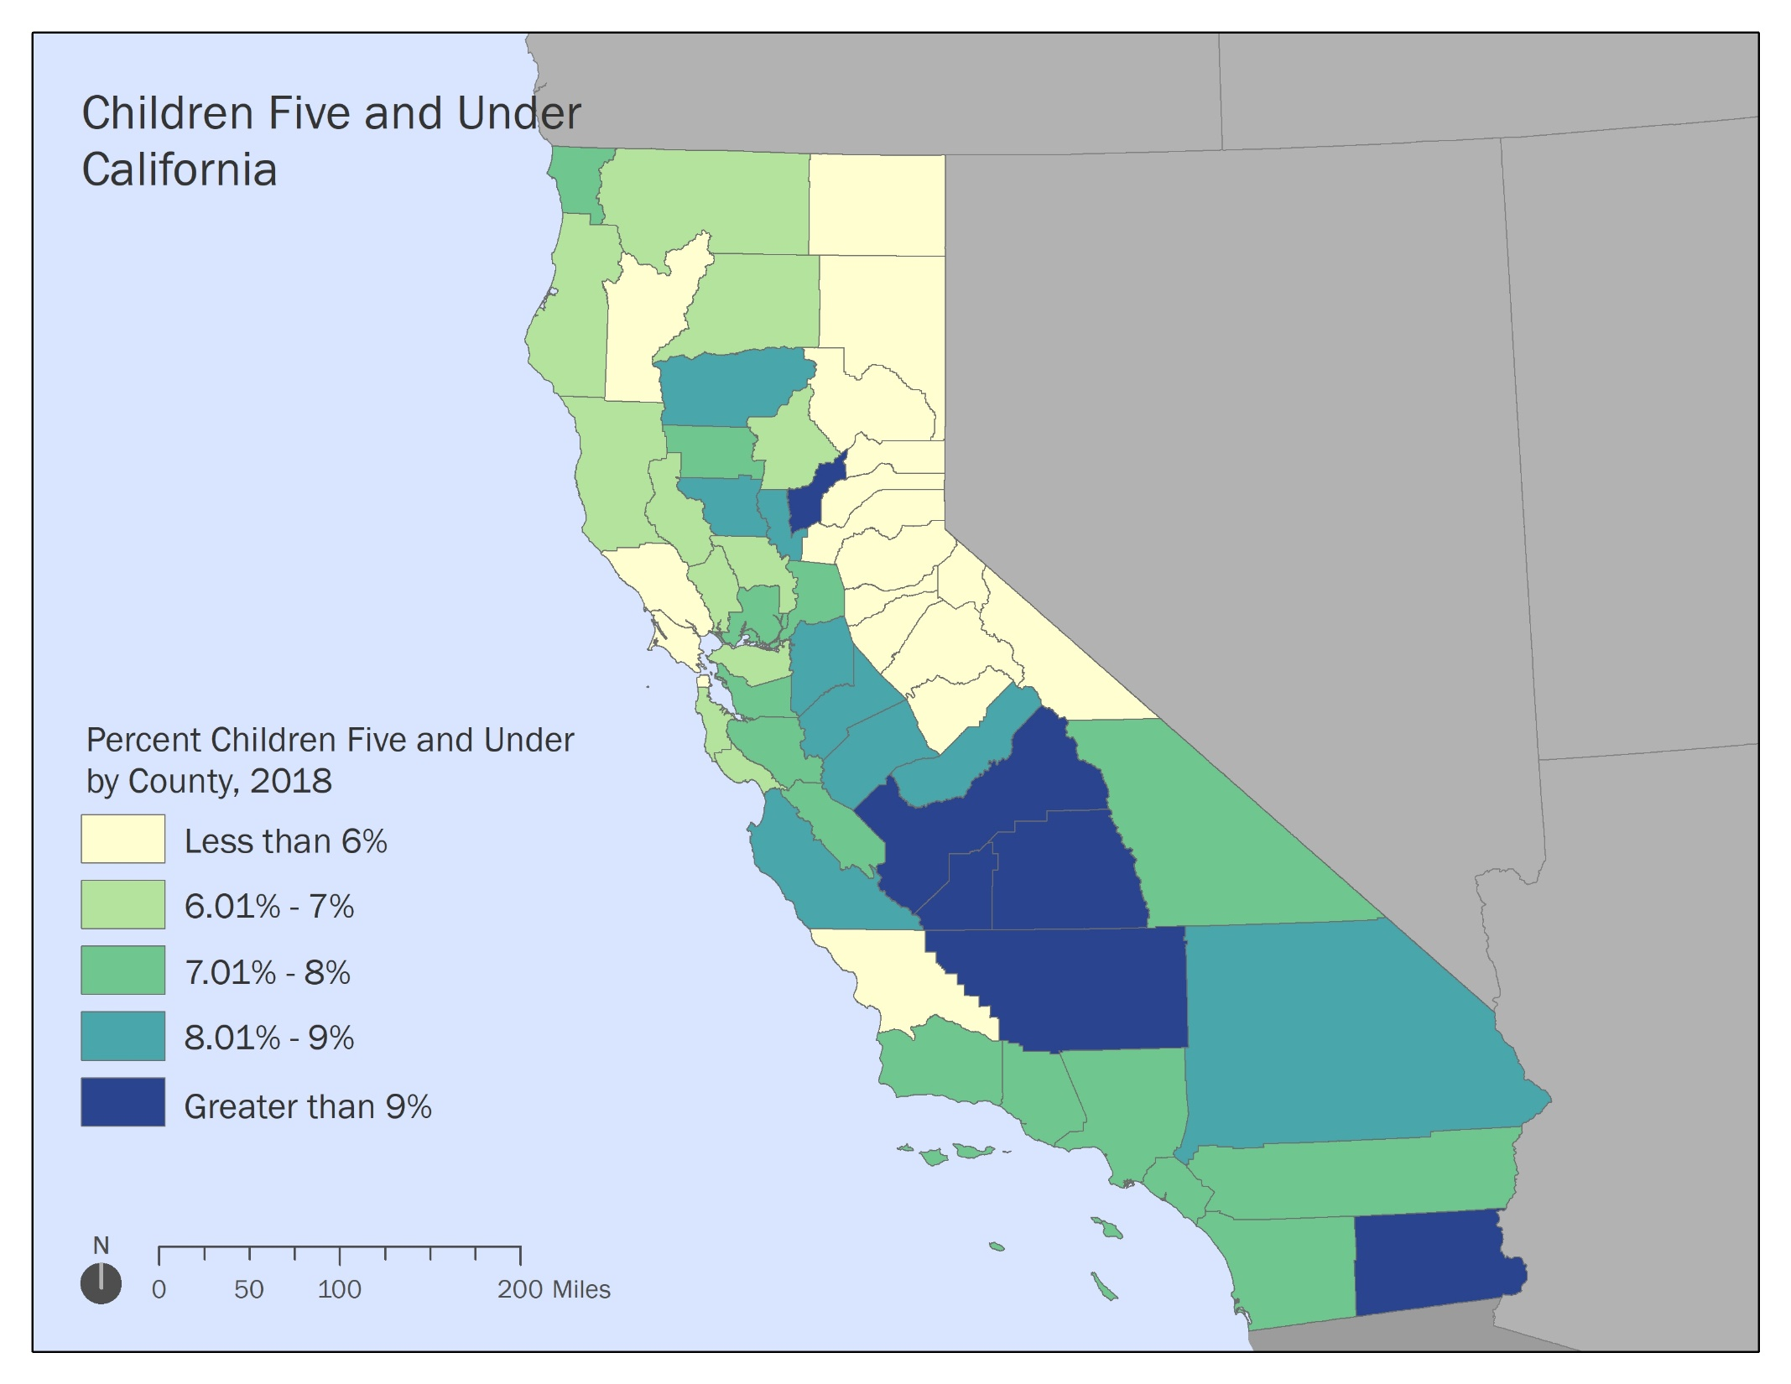
2018

Slide 13
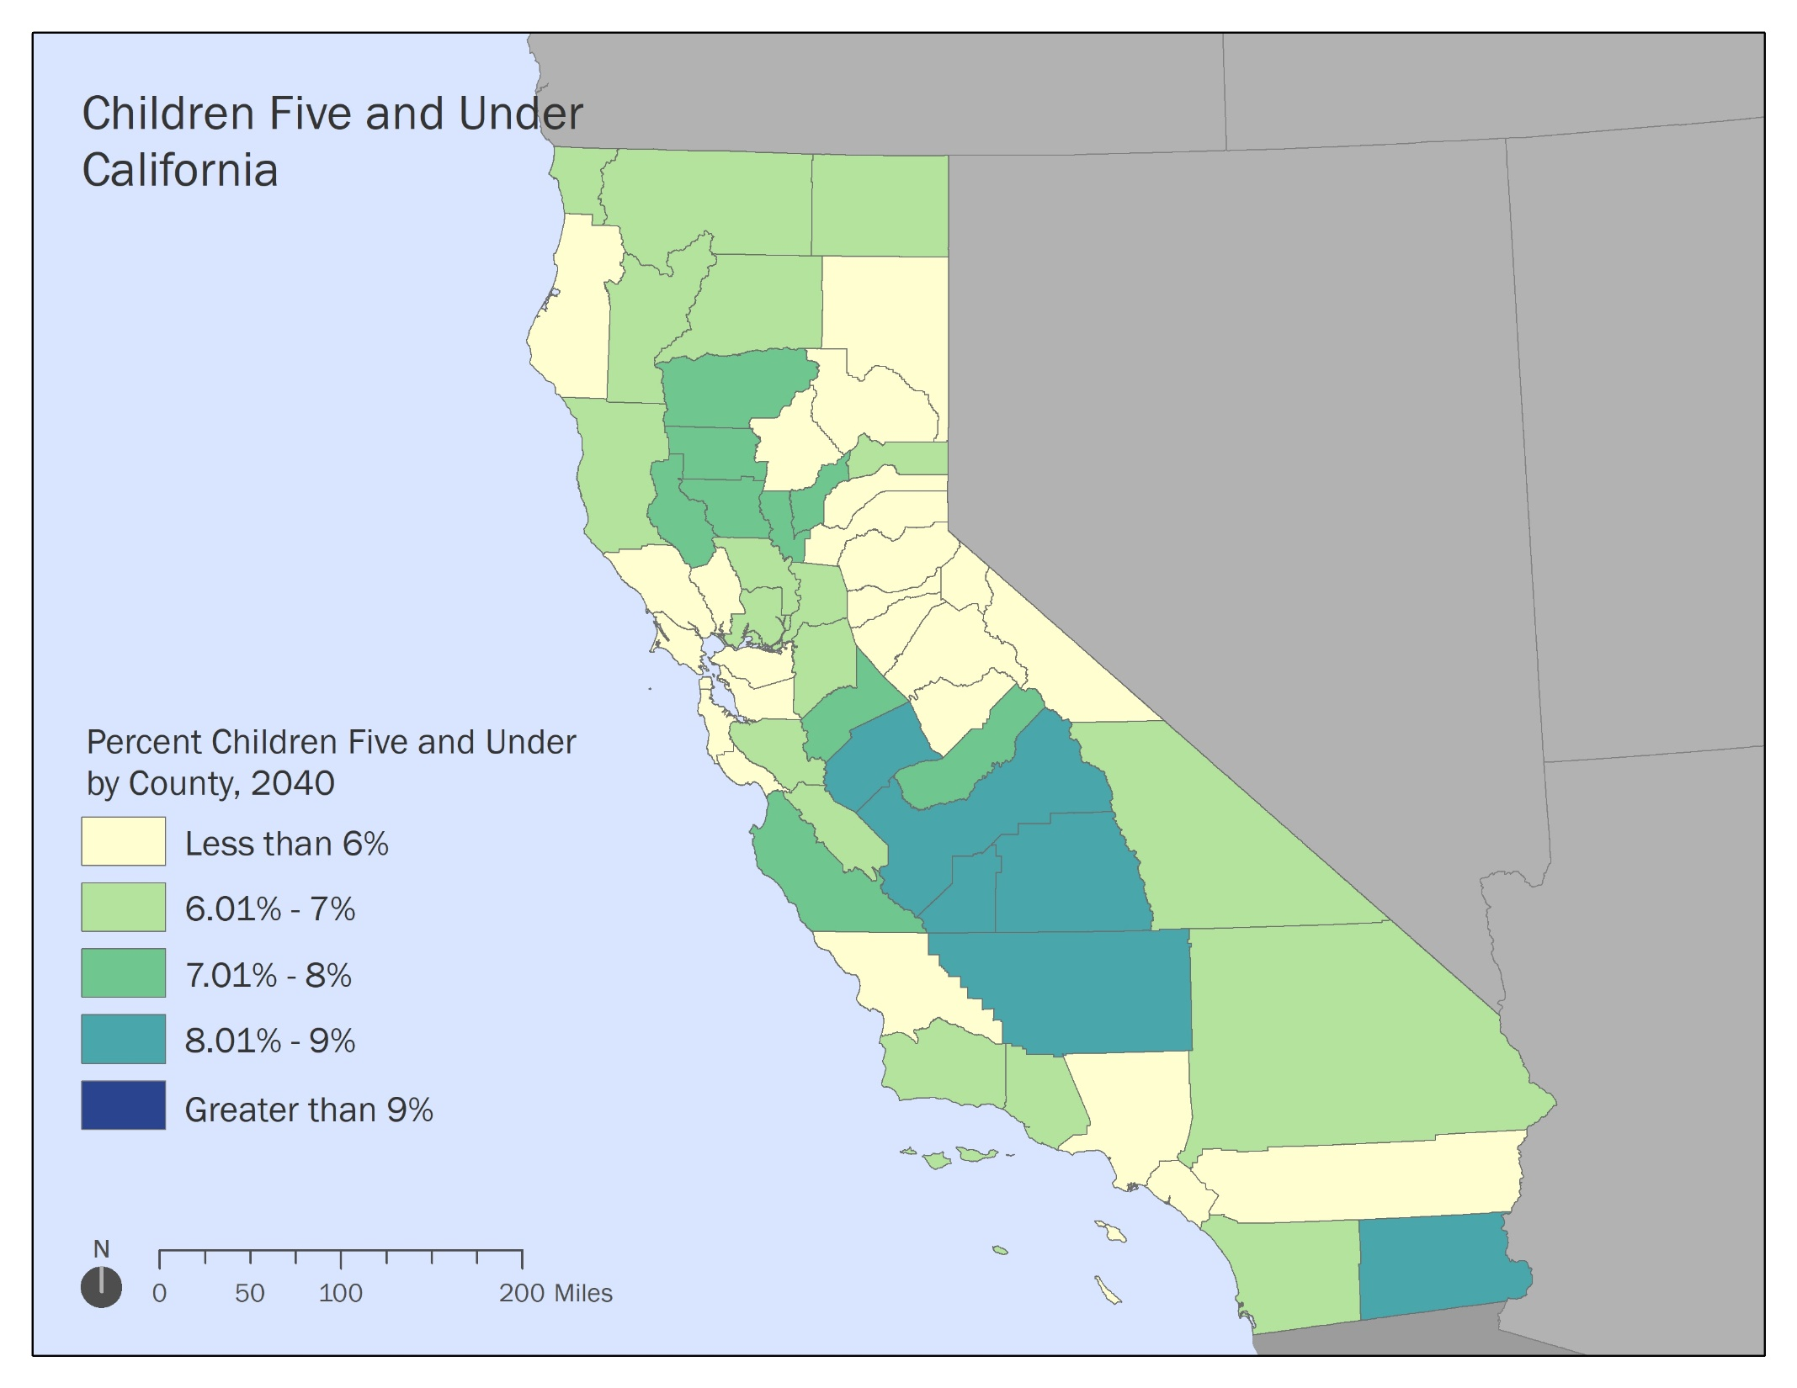
2040

Slide 14
Where are our state’s FUTURE children?
Growth rates in population five and under, according to CA DOF, 2010-2040
USC PERE| April 2018 | 14

Slide 15
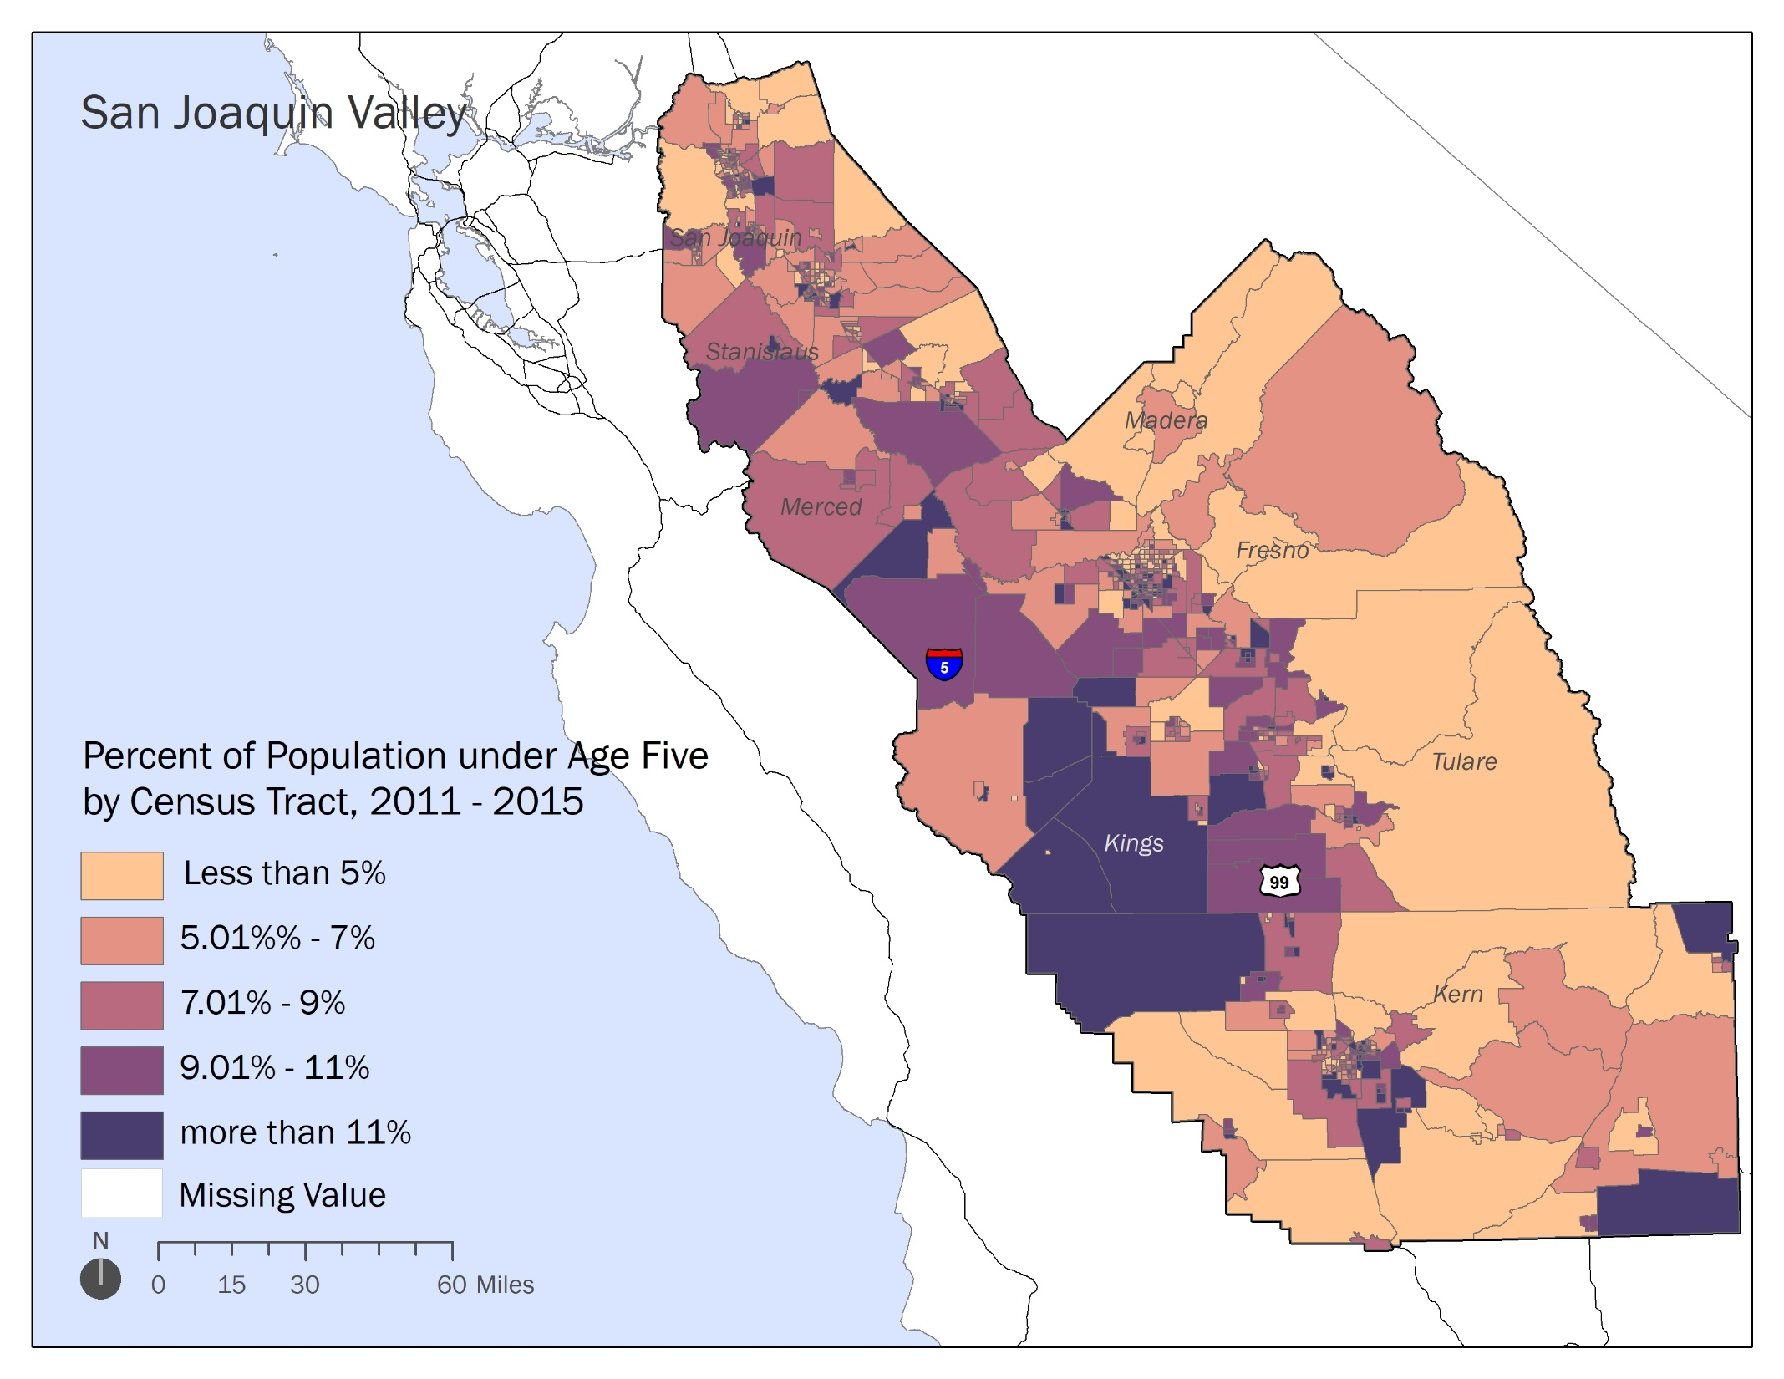

Slide 16
The Next California
This generation of children is very diverse.
Growth in the next generation will occur in Central California.
The next generation faces significant stress, particularly in Central California.
USC PERE| February 2018| 16

Slide 19
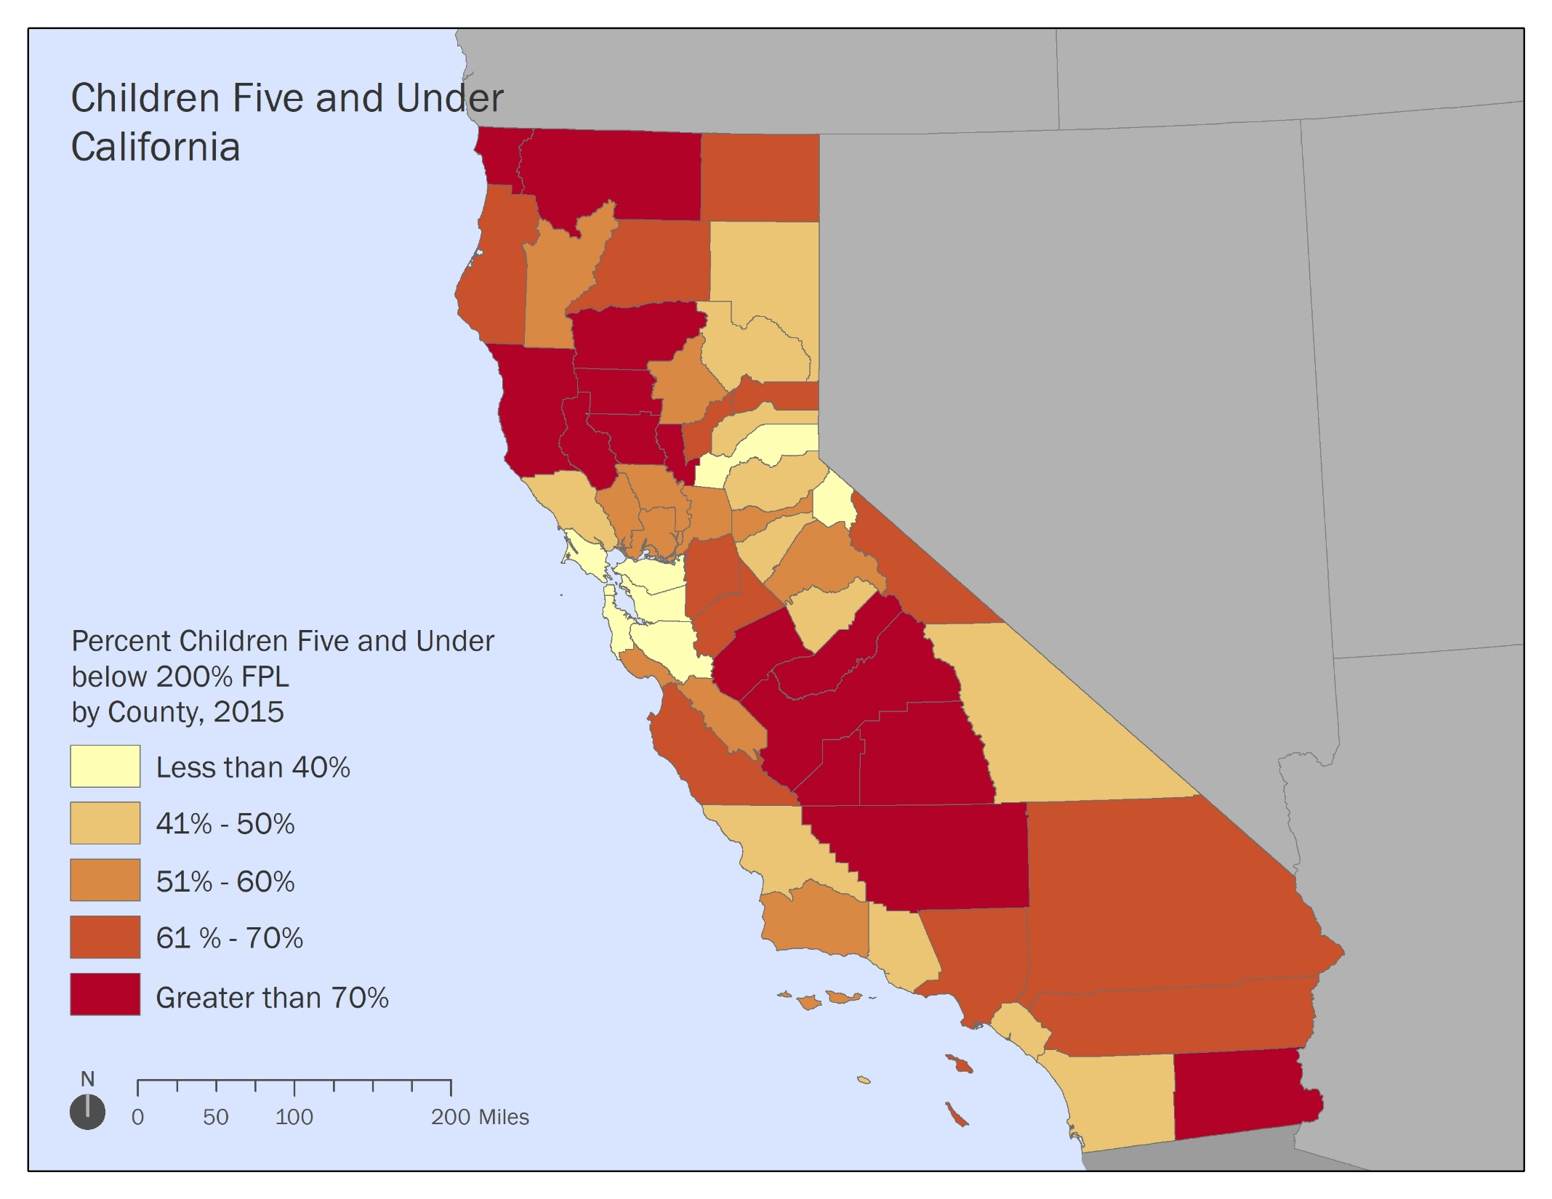

Slide 20
USC PERE| April 2018 | 20

Slide 21
USC PERE| April 2018 | 21

Slide 22
USC PERE| April 2018 | 22

Slide 23
USC PERE| April 2018 | 23

Slide 24
USC PERE| April 2018 | 24

Slide 25
The Next California
This generation of children is very diverse.
Growth in the next generation will occur in Central California.
This next generation faces significant stress, particularly in Central California.
Equity will be key to making forward progress as a state.
USC PERE| February 2018| 25

Slide 26

Equity at the Center
Implications Going Forward:
Foster knowledge communities
Offer clear and measurable working definitions of equity
Align programs and practices with equity principles
Use data to understand the cultural and social nuances of the population
Engage and build power among parents
Work to bridge the generation gap
USC PERE| April 2018 | 26

Slide 27
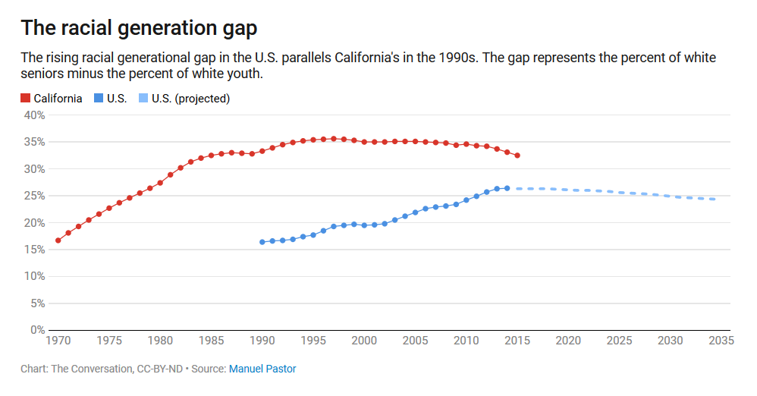
Race at the Center

Slide 28
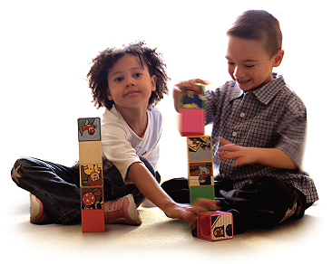
For more . . .
@Prof_MPastor

Slide 29
^{Wednesday,} ^{July 11, 2018}

Slide 30
Model Programs and Challenges to Access in the Central Valley
Matilda Soria, Fresno County Superintendent of Schools (FCSS)
Marco Jimenez, Central Valley Children’s Services Network (CVCSN)

Slide 31
Demographics of
Central Valley’s Children
Source: American Community Survey, 2016

Slide 32

Demographics of
Central Valley’s Children
County | % Children 0-5 Below Poverty
Fresno | 44.1%
Kern | 34.8%
Kings | 28.7%
Madera | 36.3%
Merced | 38.0%
Stanislaus | 23.6%
San Joaquin | 25.3%
Tulare | 40.1%
Source: American Community Survey, 2016

Slide 33
Need for Childcare in
Central Valley
Number of Children 0-2 Years | Number of Children Under 70% SMI | Number of Subsidized Slots for Children 0-2 Years
190,248 | 127,791 | 11,012
Number of Children 3-5 Years | Number of Children Under 70% SMI | Number of Subsidized Slots for Children 3-5 Years
203,393 | 130,863 | 54,307
Sources: American Institutes for Research, 2016; California Department of Social Services – Community Care Licensing, 2016

Slide 34
Decrease in Childcare Providers in Fresno County, 2003-2017
Sources: Central Valley Children’s Services Network, 2017

Slide 35
Primary Issues
Access
Data & Evaluation
Quality

Slide 36
Promising Practices
Access
Support for Informal Care Providers (i.e., CCIP and Helm Home Pilot)
Coordination efforts, including R&R, LPC, and Centralized Eligibility List
Family Resource Centers

Slide 37
Promising Practices
Quality
Build capacity of workforce, including Family/ Friend/ Neighbor care providers (e.g., Fresno Language Project)
Modify CDE’s “12 Month Eligibility” Policy
Expand participation in Quality Counts CA QRIS
Alignment between Higher Ed and CA Quality Counts/QRIS

Slide 38
Promising Practices
Data & Evaluation
Assign unique student identification numbers to 0-5 age children
Longitudinal analysis
Integration of ECE and K-12 education data with admin data of human services agencies and health care providers

Slide 39
Thank you!

